Slide 1


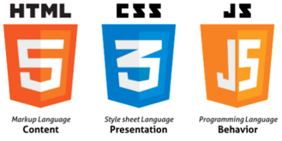












프로젝트 개발환경
Programming Languages
Databases & Frameworks
Tools
Servers
Data Formats
Libraries

Slide 2
분류 | 항목
Programming Languages | HTML, CSS, Java, JavaScript
Tools | Eclipse, GitHub
Libraries | jQuery, Bootstrap, JSTL
Databases & Frameworks | Oracle, Spring, MyBatis
Servers | Tomcat
Formats | JSON, XML

